Slide 1


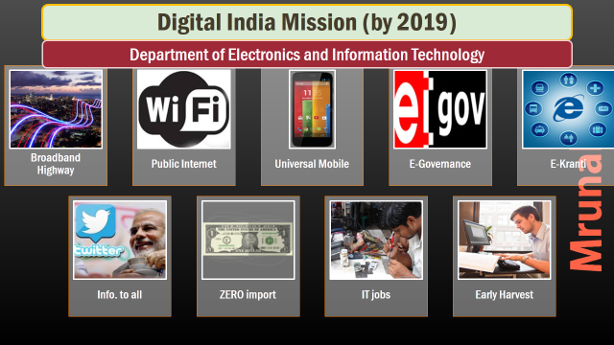
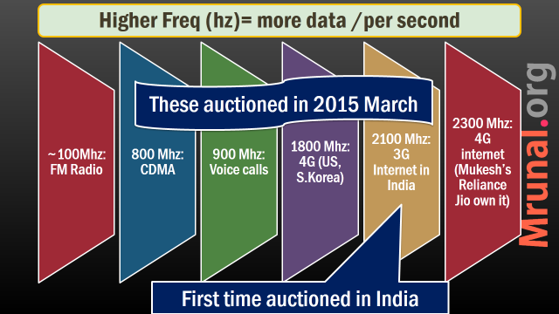
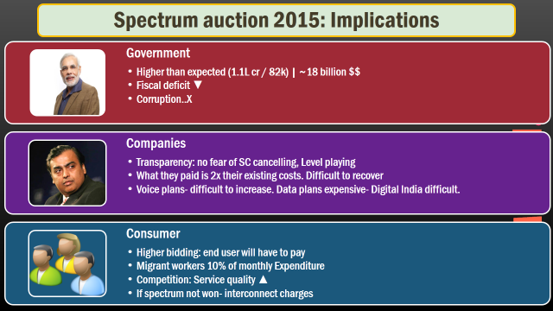

Slide 2
Environment : clash of ideas
Env. Vs Economy
1st world vs 3rd World
Climate Finance
Environment clearance

Slide 3
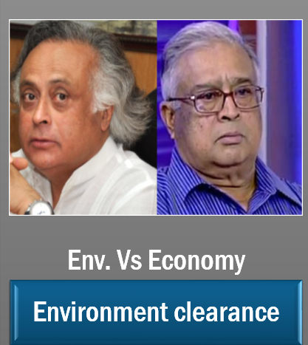
NATIONAL
Legal & Constitutional Angles
Laws Before & after independence
Green Law Panel
Pollution ▼
FRFD, DPSP, 7th Schedule
Wildlife protection, Environment clearance
Type of areas
Parks, Sanctuaries, Reserves, Hotspots, PA
Go & No Go areas?
Environment

Slide 4
Type of Sites?
Wildlife
Conservation Sites
Tiger & Elephant Reserves
Biosphere Reserves
RAMSAR Wetland
Natural World Heritage Sites
Coastal & Marine Biodiversity Areas
Protected Areas (PA)
Marine Protected Areas
National Parks
Wildlife Sanctuaries
Conservation Reserves
Community Reserves

Slide 5

“Reserves” click on links for list
Conservation Sites
Tiger Reserves
1973: Project Tiger. NTCA Statu.
#: 48 reserves, area: ~70k km²
# tigers- Central India, Eastern ghat > Western Ghat > Shivalik-Ganga > NE
Elephant Reserves
Max Pop. Kerala / Karnataka (>6k , census awaited) > Assam (5k)
Min. Pop. Maharashtra (4)
Ramsar Wetland sites (26)
Highest in J&K (4)
Guj: Nalsarovar
Notes:
North East and bramhaputra flood plains

Slide 6
Biodiversity Hotspot: World (34) India (4)
Himalaya
Western Ghat-Sri Lanka
India: Western & Eastern Himalaya
India: W.Ghat
Sundaland
India: Nicobar
Indo-Burma
India: North East
Sundaland:
Indo-Malay Peninsula
Singapore, Thailand, Brunei etc.
Concept by
British Ecologist
Norman Myers (‘88)

Slide 7


Biodiversity hotspot (4)
Biosphere reserves (18)
Himalaya
Indo-Burma
Western Ghats & SriLanka
Sundaland (Nicobar)
4 because (1) TSR Page 29 (2) India CBD submission Dec 2014
UNESCO's Man and the Biosphere (MAB) 70s.
India: Nilgiri notified in ‘86
Total 18 Click me for List
Out of that 9 recognized in UNESCO (IYB Pg.299)
Notes:
9 x 2 = 18

Slide 8

UNESCO World Heritage sites
Conservation Sites
Sl. No. | Name of WH Site | State | Notified | Area
1 | Kaziranga National Park | Assam | 1985 | 429.96
2 | Keoladeo Ghana National Park | Rajasthan | 1985 | 28.73
3 | Manas Wildlife Sanctuary | Assam | 1985 | 391.00
4 | Nanda Devi National Park and Valley of Flowers | Uttarakhand | 1982 2005 | 630.00 87.50
5 | Sunderbans National Park | West Bengal | 1984 | 1,330.10
6 | Western Ghats | Maharashtra, Goa, Karnataka, Tamil Nadu and Kerala | 2012 | 1,60,000.00
7 | Great Himalayan National Park | Himachal Pradesh | 2014 | 905.4

Slide 9
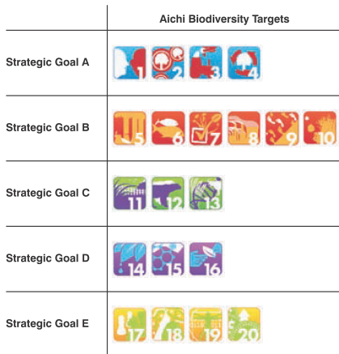
ICMBAs
Conservation Sites
Important Coastal and Marine Biodiversity Areas
Under Aichi Biodiversity Target
Total 106 in India
Western Coast (62)> Eastern (44)
Highest #: Kerala (18), Andhra (17), MH (16), Guj (14)

Slide 10
Type of Sites?
Wildlife
Conservation Sites
Tiger & Elephant Reserves
Biosphere Reserves
RAMSAR Wetland
Natural World Heritage Sites
Coastal & Marine Biodiversity Areas
Protected Areas (PA)
Marine Protected Areas
National Parks
Wildlife Sanctuaries
Conservation Reserves
Community Reserves

Slide 11
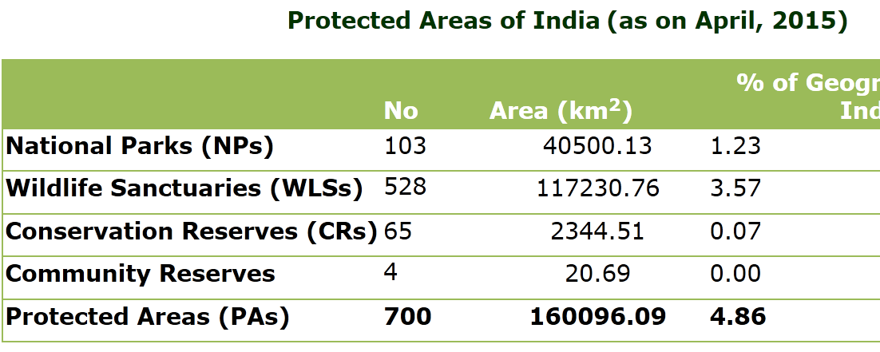
Wildlife institute of India, Dehradun

Slide 12
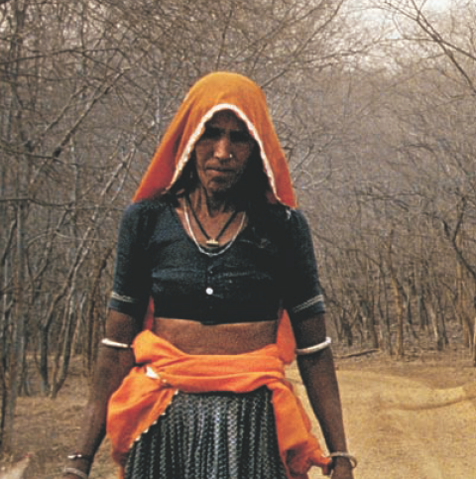

National Park 103
PA
No human activity / settlement
unless Wildlife warden permits (tendu leaves / honey collection)
NP area: Uttarakhand > Raj > J&K
NP #: MP | A&N (9 each).
FOUR IN Gujarat
ZERO in Punjab, Chandigarh, Diu-DN, Delhi, Lakshadweep, Pondicherry

Slide 13

Wildlife Sanctuaries 528
PA
Some human activities permitted- firewood collection, grazing, tourism
Highest Area: Guj > J&K >Andhra
Highest #: A&N (96), MH (40), HP (28)
At least 1 Wildlife sanctuary present in every state / UT

Slide 14
Find correct statement
Each State of India, has atleast 1 national park.
In protected areas, all type of human activities are prohibited.
Both A and B
Neither A nor B
Ans. D.

Slide 15
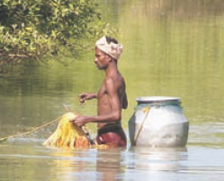
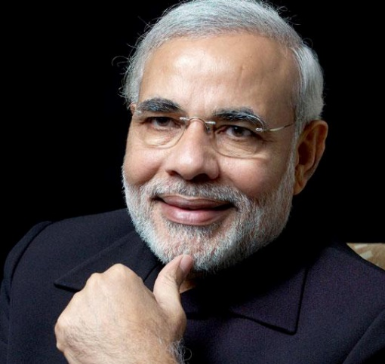
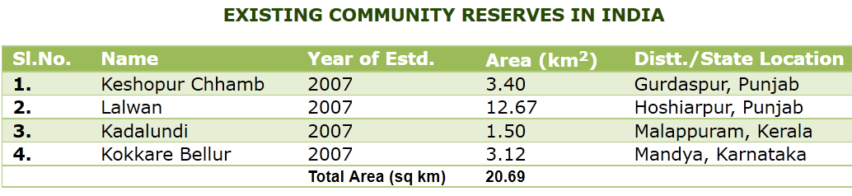
Buffer zone, connector, migration corridors b/n NP/W. Sanctuaries
Conservation reserve
Community reserve
If entire land is Government owned.
More in number and size.
If some land privately owned. (2007)

Slide 16
Type of Sites?
Wildlife
Conservation Sites
Tiger & Elephant Reserves
Biosphere Reserves
RAMSAR Wetland
Natural World Heritage Sites
Coastal & Marine Biodiversity Areas
Protected Areas (PA)
Marine Protected Areas
National Parks
Wildlife Sanctuaries
Conservation Reserves
Community Reserves

Slide 17

Go & No Go Areas for mining?
UPA (mid’10)
CAT-A (No Go areas)
10% weighed forest cover OR
CAT-B (Go Areas)
Not in CAT-A
30% gross forest cover.
PILs in SC about more stringent Go-no-go for all projects

Slide 18

Green Law Panel (‘14): What is “No Go” area?
Conservation
Conservation Sites
Tiger & Elephant Reserves
Biosphere Reserves
RAMSAR Wetland
Natural World Heritage Sites
Coastal & Marine Biodiversity Areas
Protected Areas (PA)
Marine Protected Areas
National Parks
Wildlife Sanctuaries
Conservation Reserves
Community Reserves
No Go area
Protected Areas
Forest with 70% canopy

Slide 19
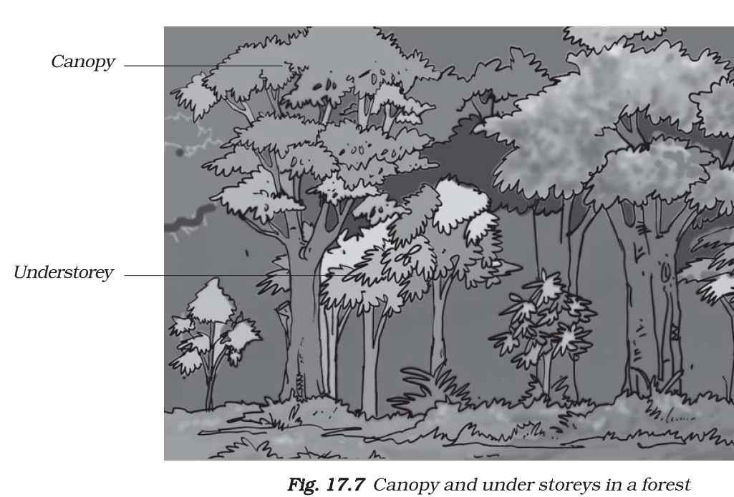
Canopy: tall tree’s branches act as “roof” over others
NCERT
Class 7: chapter 17

Slide 20
NCERT: environment +NIOS
CLASS | SUBJECT | CHAPTERS
6 | geography | 8
7 | geo. | 1 to 6
 | science | 7, 16 to 18
8 | geo. | 8
 | sci. | 7 & 18
9 | geo | 5
 | science | 14
10 | Geo. | 2
 | sci. | 14 to 16
11 | geo(Physical) | 15 & 16
 | geo (India) | 4 & 5
 | economy | 9 (Sustainable development)
12 | Biology | 13 to 16
 | chemistry | 14

Slide 21
NCERT Science-irrespective of degree
Class | PHYSICS | Chemistry | Biology
7 | 4, 13, 14 & 15 | 5 & 6 | 1,2,10; 11 & 12
8 | 11 to 16 | 3 to 6 | 2, 8, 9 & 10
9 | 8 to 12 | 1 to 4 | 5,6,7 & 13
10 | 10, 12 & 13 | 1 to 5 | 6 to 11
11 | 1,5,8 | 1,14 | 2 to 5
12 | 15 | 14,16 | 4,5 then 7 to 16
Green: Environment related
+Psychology Ch4

Slide 22

IYB chapters completely
1: land and people
12: Environment
30: State and Union territories
Forest survey 2013 article

Slide 23
NATIONAL
Legal & Constitutional Angles
Laws Before & after independence
Green Law Panel
Pollution ▼
FRFD, DPSP, 7th Schedule
Wildlife protection, Environment clearance
Type of areas
Parks, Sanctuaries, Reserves, Hotspots, PA
Go & No Go areas?
Environment

Slide 24
Before independence
Env. laws
1865: Forest act
1927: Indian Forest act
Exploitation of sal and teak for Railway sleepers
Timber export to Europe
Govt. gave 'right to exploit' forest produce based on loyalty of a tribe/community.

Slide 25
FR-FD DPSP
Environment
21
sustainable development linked to ‘right to life’
47
"The State shall regard the raising of the level of nutrition and the standard of living of its people and the improvement of public health as among its primary duties
51-A(g)
It shall be the duty of every citizen of India to protect and improve the natural environment including forests, lakes, rivers and wildlife and to have compassion for living creatures."
48-A
The State shall endeavor to protect and improve the environment and to safeguard the forests and wildlife of the country".

Slide 26
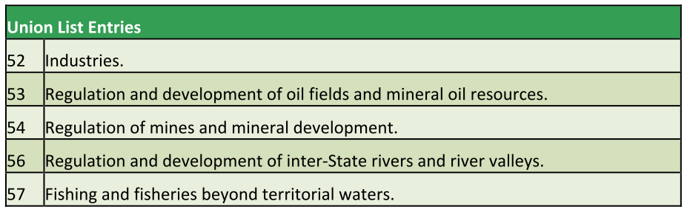
7th Schedule: Union List

Slide 27
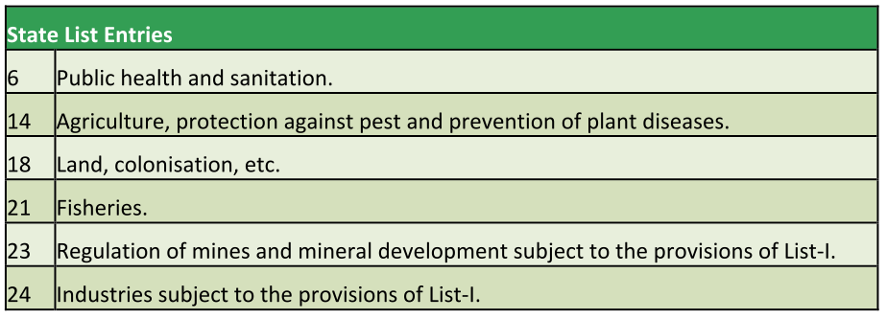
7th Schedule: State List
Water in state list. But Art. 252: consent of 2/more states – parliament can legislate. So Water Act 1974
Notes:
The Water (Prevention and Control of Pollution) Act, 1974
Article 252 in The Constitution Of India 1949
252. Power of Parliament to legislate for two or more States by consent and adoption of such legislation by any other State (1) If it appears to the Legislatures of two or more States to be desirable that any of the matters with respect to which Parliament has no power to make laws for the States except as provided in Articles 249 and 250 should be regulated in such States by Parliament by law, and if resolutions to that effect are passed by all the House of the Legislatures of those States, it shall be lawful for Parliament to pass an Act for regulating that matter accordingly, and any Act so passed shall apply to such States and to any other State by which it is adopted afterwards by resolution passed in that behalf by the House or, where there are two Houses, by each of the Houses of the Legislature of that State
(2) Any Act so passed by Parliament may be amended or repealed by an Act of Parliament passed or adopted in like manner but shall not, as respects any State to which it applies, be amended or repealed by an Act of the Legislature of that State

Slide 28
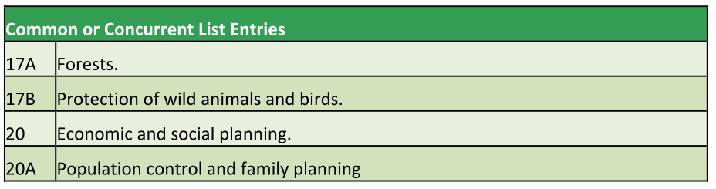
7th Schedule: Concurrent List
Environment: “residual” matter.
Only parliament can legislate.

Slide 29
Correct Statement
Parliament of India has enacted laws on water and environment, using its power to legislate on state list, by consent of two or more states.
If parliament enacts law on state matters under Art.252, its mandatory for all states to implement it.
Both A and B
Neither A nor B
Ans. D

Slide 30
Laws & Policies-Chronology: 50s to 70s
1952
India's 1st Forest policy: 1/3rd of land be covered with Forest => 1988 updated.
1972
Wildlife protection act- create protected areas, prohibit hunting, animals classified in 6 schedules. National and state wildlife boards.
1972
UNEP: (UN Environment program) Stockholm declaration for human environment.
Water Act 1974=>Water pollution control board, and Water Cess Act. Air Act 1981

Slide 31
Chronology: 80s
1980
Forest Conservation Act- regulate and restrict the diversion of forest land for non- forest purpose
1983
National Wildlife Action Plan: in-situ conservation with Junta support.
1984
Bhopal Gas Disaster => 1986: Environment protection Act.
Union to laydown pollution norms, effluent standards, industrial safeguard, inspection etc.
Hazardous waste management rules ('89-2008 updated)

Slide 32
Chronology: 90s and afterwards
1991
Costal regulation zones (CRZ) => update in 2011
1994
Environment Impact Assessment Notification, update in 2006
2002
Biodiversity act
2010
National Green Tribunal

Slide 33
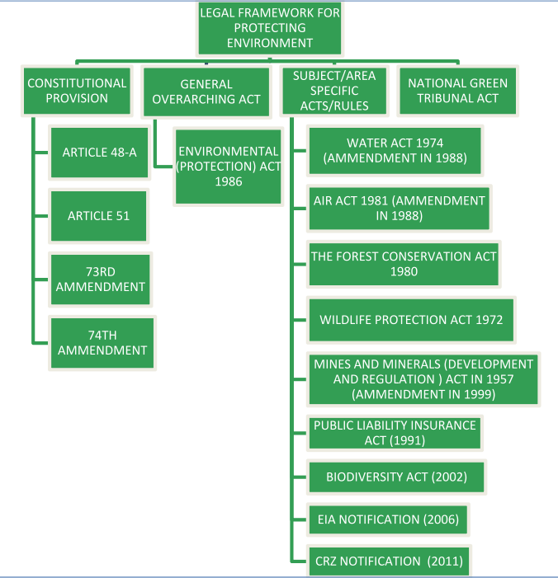

Slide 34
NATIONAL
Legal & Constitutional Angles
Laws Before & after independence
Green Law Panel
Pollution ▼
FRFD, DPSP, 7th Schedule
Wildlife protection, Environment clearance
Type of areas
Parks, Sanctuaries, Reserves, Hotspots, PA
Go & No Go areas?
Environment

Slide 35
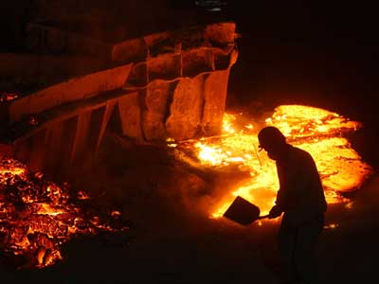
People Problem?
Environment
Population growth
unplanned urbanization.
inappropriate technology
polluting industries proliferating.
Inappropriate consumption choices
Harmonious coexistence gone

Slide 36
Separation of Power UNEVEN
Legislature
Laws with Multiple interpretation
Penalties low
Executive
Lack of sensibilities, impulsive actions
Judiciary
Intervenes @slightest & first pretext (J. Activism)
At 1st sight- not to provide solution but to complicate issues further (TSR Subramanian)
NGO, Civil Society, Media activism
Policy paralysis, inconsistency, red-tapes
Outdated in present context
Environment

Slide 37
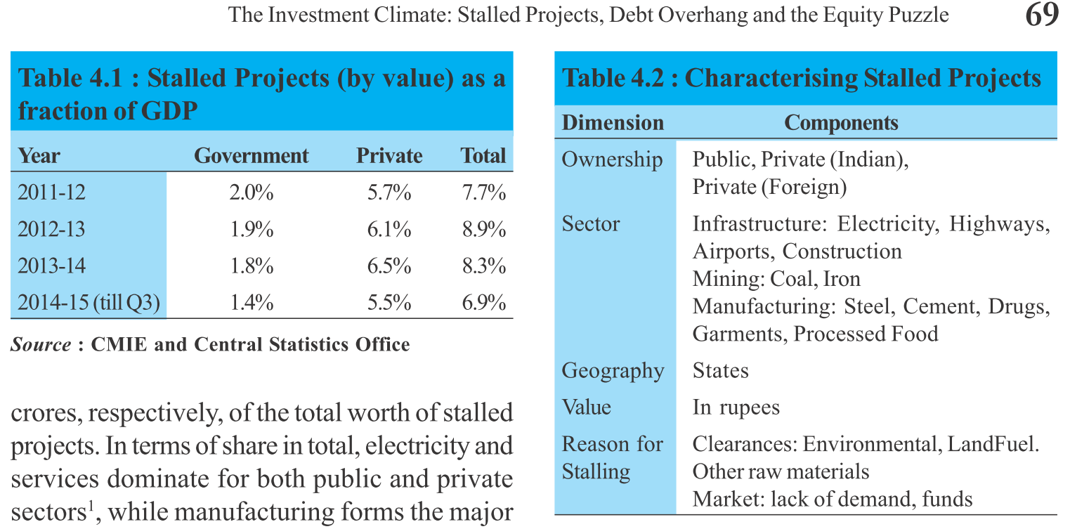
End result: stalled projects: L7P1.pptx

Slide 38
Committee Sep-2014 Nov-2014
Way ahead
Former Cabinet Secretary TSR Subramanian
High level Committee to review environmental laws a.k.a Green Law Panel
By Ministry of Environment, Forests & Climate Change (MoEF&CC)

Slide 39
Review these 5 Acts
Mandate
Wildlife (Protection) Act, 1972
Water (Prevention and Control of Pollution) Act, 1974
Forest (Conservation) Act, 1980
Air (Prevention and Control of Pollution) Act, 1981
Environment (Protection) Act, 1986
Remember chronology for MCQ

Slide 40
Sch. 1 to 4
Protected species
5
Vermins & pests: crow, fruitbat, mice, rats (large size, small ears)
6
Plant species
TSR: update
Descending order of legal protection
States want Nil gai, Monkeys Wildboars here
TSR: no need, you’ve have powers to take action for socio-eco. interest

Slide 41
Find correct Statement(s)
African fruit bat is considered to be the natural host for the Ebola
Indian Fruitbat is a protected species under Sch.1 of Wildlife protection Act 1972.
Both A and B
Neither A nor B
Ans. A

Slide 42

WLP ’72 Nag Panchami
Green Law Panel
Nature and animal worship has been part of the national culture and local festivals.
TSR: Amend WLP so people are not harassed for petty things, as long as animals are not harmed.
Example Nag Panchami: 5 day worship of snakes in Shravan month
Activists angry

Slide 43
SC Order 2006
Only 29 zones
in 10 states.
TSR: ask all in deadline
Human Settlement
Buffer / Eco Sensitive Zone
Protected Areas (700)
Parks
Community reserves
Sanctuaries
Conservation reserves
TSR: states don’t need permission to ▲ PA boundary
Notes:
Eco fragile zone

Slide 44

WLP’72 TRAPS
Green Law Panel
Poachers use Leg and mouth hold-traps against tigers and leopards
Possession Traps of traps illegal inside Protected Area (PA)
But outside PA, their mfg. and possession not illegal ☹
TSR: make it illegal everywhere, except for educational display

Slide 45

WLP’72 Poly.bags
Green Law Panel
Protected areas: explosive, poison, chemicals banned
But polythene bags thrown casually
TSR: ban them

Slide 46

WLP’72 Personnel
Green Law Panel
Wildlife Institute of India (WII), Dehradun
Their Forensic expert identify animal parts confiscated during raids
Courts require physical presence during trial, but WII-manpower low.
TSR: give'em 'Expert' status @CrPC (Sec.293)
International Border Areas
Local police / forest officials can't reach.
TSR: Better delegate powers to BSF / ITBP etc. to check against intl. wildlife trade.
Notes:
293. Reports of certain Government scientific experts.
(1) Any document purporting to be a report under the hand of a Government scientific expert to whom this section applies, upon any matter or thing duly submitted to him for examination or analysis and report in the course of any proceeding under this Code, may be used as evidence in any inquiry, trial or other proceeding under this Code.
(2) The Court may, if it thinks fit, summon and examine any such expert as to the subject- matter of his report.
(3) Where any such expert is summoned by a Court and he is unable to attend personally, he may, unless the Court has expressly directed him to appear personally, depute any responsible officer working with him to attend the Court, if such officer is conversant with the facts of the case and can satisfactorily depose in Court on his behalf.
(4) This section applies to the following Government scientific experts, namely:-
(a) any Chemical Examiner or Assistant Chemical Examiner to Government;
(b) the Chief Inspector of- Explosives;
(c) the Director of the Finger Print Bureau;
(d) the Director, Haffkeine Institute, Bombay;
(e) the Director 1 , Deputy Director or Assistant Director] of a Central Forensic Science Laboratory or a State Forensic Science Laboratory;
(f) the Serologist to the Government.

Slide 47
Green Law panel: Reforms in Wildlife Protection Act
Vermin
Buffer ESA
Traps & Bags
Expert /BSF
Nag Panchmi

Slide 48

Problem in present structure
Env. Clearance
Depending on size of project & possible impact on health/nature
All Projects: Cat A (Union) / Cat B (state)
Environment Impact Assessment (EIA) => Environment Clearance.
Professional manpower….x
Scientific assessment….x
4 stages: screening, scoping, public consultation and appraisal : overlapping / duplication of certificates

Slide 49
Problem in present structure
Env. Clearance
No penalty for false info.
CRZ panel separate.
State and Central Pollution control board have not much to say.
Inspector raj, red tapes, aversion to clear files due to media/judicial scrutiny

Slide 50

Way Ahead?
Env. Clearance
SC- need to setup a statutory body to implement forest policy '88. (Lafarge Cement Case)
TSR: a new ‘umbrella’ law – Environmental laws (Management) Act (ELMA) 2014

Slide 51
New Bodies in ELMA 2014
NEMA
UTEMA
National Environment Management Authority
CAT A projects
SEMA
State Environment Management Authority
Cat B projects
Union Territory Environment Management Authority
CAT B in UT
Reclassify to put more projects in Cat.B, else 8k Cat-A files pending in MoEF

Slide 52

NEMA
Env. Clearance
National Environment Management Authority (NEMA)
Chairperson- atleast addl.Secretary level experience
Members- environment, forest etc. experience
Min. 2 members with 15 years academics
Max. 15 persons
Age limit: 65 years.

Slide 53
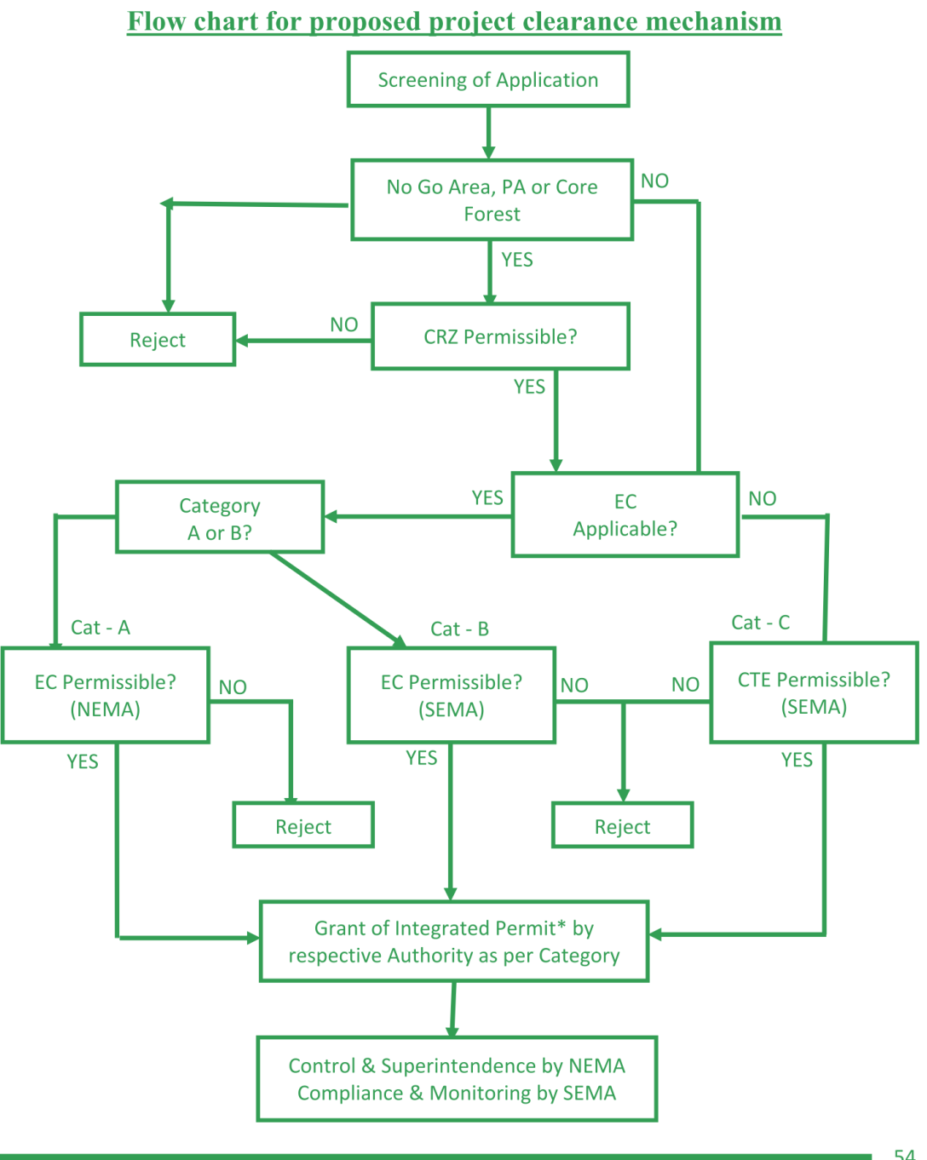
NEMA, SEMA: project environment clearance

Slide 54
Appeal Structure
I
II
III
NEMA
SEMA
Appellate board
Retired HC judge
2 Addl.Secy rank
National Green Tribunal (NGT)
Frivolous appeals: penalties

Slide 55
NEMA SEMA Addl. duties
Env. Clearance
NEMA, SEMA, UTEMA=> Cat A | cat B
Monitor compensatory afforestation
Technical cells for pollution control, remote sensing, satellite imagery, biodiversity, thermal power etc.
Prepare environment maps, pollution maps.
Advisory to respective ministries

Slide 56

NEMA SEMA Fast tracking
Env. Clearance
Preliminary scrutiny in 10 days
Use Geo-coordinates to automatically reject files for "no go" areas (PA+forest with 70% canopy)
Remote sensing, satellite imagery, & other tech. to ▼ inspector raj.
Self certification with “Good faith” provision like in insurance laws (void IF false info / info. hidden + penalty)

Slide 57
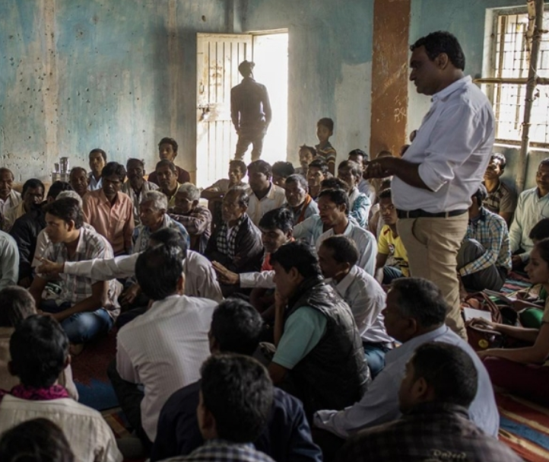

Public Hearing NOT required IF
Env. Clearance
If not "genuine" (crowd of outsider activists / paid villager mob)
If planned industrial zone or manufacturing zone. (NIMZ, DMIC)
Settlements far away from site.

Slide 58
Public Hearing NOT required IF
Env. Clearance
All the strategic border projects within 20kms from intl. border / LoC / LAC
Border roads, fencing
Border Out Posts, floodlighting
Surveillance infrastructure, power infrastructure
Linear projects, Power and coal mining projects "MAY BE" fast tracked without public hearing

Slide 59
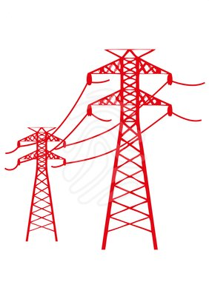
Linear Projects Fast track
Env. Clearance
Rail line, roads, gas pipelines, irrigation canals, transmission lines.
Benefit of the community at large. Give priority clearance, public hearing may be ignored.
But if Linear project in core forest area=> no approval.
Except re-laying / repairing existing road. Can’t widen more.
Activists Criticize this

Slide 60

Misc. reforms
Env. Clearance
Consolidate 150 circulars, Office memorandum & amendments
Water Act and Air Act provisions- subsume within EPA (environment protection act)
CRZ area definition on high tide line (HTL)- changes from time to time- implement tech.Committee report when comes.
Coal / Mines : 5 year plan with afforestation. Special cell in NEMA.
Notes:
Of last eight years

Slide 61
Compensatory Afforestation
Area
Private Land / Revenue land
Present
TSR
1:1
2:1
Then we can’t ▲ 24% to 33% forest cover ☹

Slide 62
Compensatory Afforestation
Area
Private Land / Revenue land
Present
TSR
1:1
2:1
Degraded Forest
2:1
3:1

Slide 63
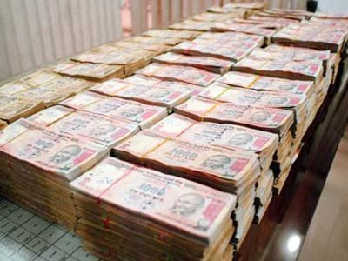
If can’t plant trees
Afforestation
Pay $$ in CA fund & get approval.
TSR: Net present value of forest (raise to 5x than current norms.)
State wise separate definition for “forest”.
Tree / plantation in private area = not “forest” but “treeland”, ELSE harassment of farmers / companies.

Slide 64

Add. funding
Afforestation
Environment Reconstruction Fund.
Under MoEF or NEMA
$$ to come from cess (air | water), Surcharge (vehicle | effluent discharge), environmental reconstruction cost from pvt. Companies
$$ use for afforestation, R&D, "green awareness program“

Slide 65
Green Law Panel: Reforms in Environment Clearance
ELMA, NEMA, SEMA
Public Hearing
Linear Projects
Afforestation Ratio
Env. Reconstr. Fund

Slide 66

Municipal waste
Pollution
Million plus cities (53): Green Rating system.
Next 3 years, 20% more solid waste handling
Use muni.solid waste as fuel in cement and steel plants.
Integrate rag pickers in SWM (Solid waste Management
Biomedical waste handling unit @ Each hospital
Add to L7P3: SBM | L7P4 (smart City)

Slide 67

Vehicle pollution
Pollution
Bharat-IV norms being introduced
But car # ▲ so much, no better engine /fuel can ▼ overall GHG
TSR: Change tax system to ▼ vehicle purchase
Entry fees on vehicles in certain areas.

Slide 68

Noise pollution
Pollution
Rules under Air act but no separate act for noise pollution
control crackers use / mfg….X
Control loudspeakers from religious places….x
TSR: Abolish Air act, but Make provisions in Environmental Protection Act

Slide 69

Higher Education
Org
Environment research institute: for designing diploma/UG/PG courses in environment
IITs, and (pub + private) engineering colleges : monitoring air-water quality

Slide 70

New all India service
Org
"Quasi-Amateur” personnel in environment clearance / pollution control bodies.
Create a new All India Service – Indian Environment Service
To work in public and quasi-Government sectors
Open recruitment through DoPT/UPSC
IFS: give subject specialist training: forest conservation, wildlife, social forestry

Slide 71

GM crops vs. MoEF
Org.
Genetically Modified (GM) food crops
Europe does not permit field trials
Average Indian farm is of very small size.
no independent expert agencies for projecting medium-long term impacts
So, Due care needs to be taken
Eco.Survey : no evidence of health damage=> so BT approve. (L5/P2.pptx)

Slide 72
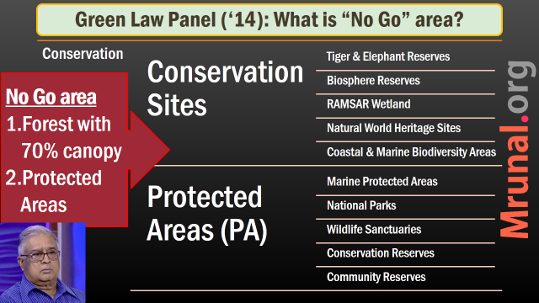
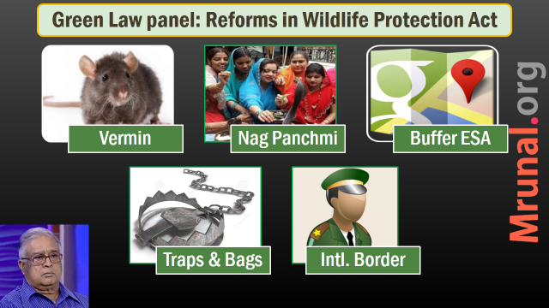
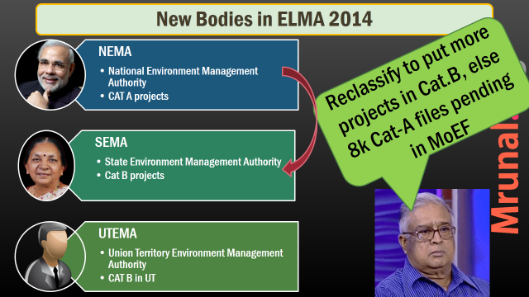
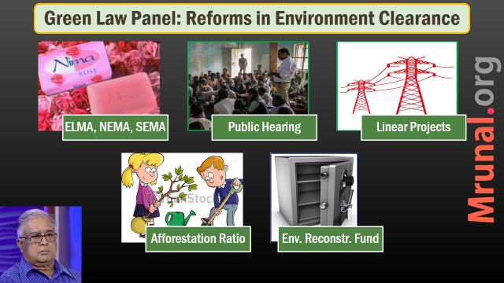

Slide 73
Reforms for Pollution & Organization
Muni Waste
Vehicles
Noise
Higher Education
New AIS
Sci-Tech (GM)

Slide 74

TSR Green Law Panel
Criticism
Diluting Wildlife protection act (Nag panchmi)
Diluting Public hearing
Fast tracking of linear projects.
Companies => $$ to Compensatory afforestation fund, but what if not utilized?
Proliferation of bodies NEMA, SEMA, new environment services etc.

Slide 75
Mains / Interview
The principal aim of Environment regulation should be to balance Ecological & Economic needs of India. Critically examine the lacunas in present legal-Administrative framework & suggest remedies.

Slide 76
Answer
Examine Lacuna
Suggest Remedies
XO: inconsistent policy, impulsive implementation, multiple agencies, centralization.
Legal: multiple interpretation, low penalties
Judiciary intervention, separation of power uneven.
NEMA, SEMA single window
Public hearing, linear project
Compensatory afforestation, Forest vs. treeland
MSW as fuel for cement, steel. Tax on vehicles

Slide 77
WRITE Essay on following
Nature is the source of all material things: the Maker, the means of making, and the things made. (Isha Upanishad)
“Environmental conservation is about negotiating the transition from past to future in such a way as to secure the transfer of maximum significance.” (Holland and Rawles, 1930)
Notes:
ईशोपनिषद्

Slide 78
Env. Vs Economy
1st world vs 3rd World
Climate Finance
Environment clearance
Next time
Legal & Constitutional Angles
Laws Before & after independence
Green Law Panel
Pollution ▼, Org. reforms
FRFD, DPSP, 7th Schedule
Wildlife protection, Environment clearance
Type of areas
Parks, Sanctuaries, Reserves, Hotspots, PA
Go & No Go areas?

